Slide 1

OpenStudio: The Developer’s Modeling Platform
ASHRAE/IBPSA SimBuild 2016
Amir Roth, DOE
Daniel Macumber, NREL
And a cast of several dozen
http://openstudio.net/

Slide 2
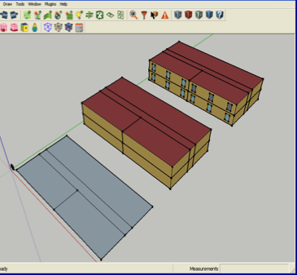
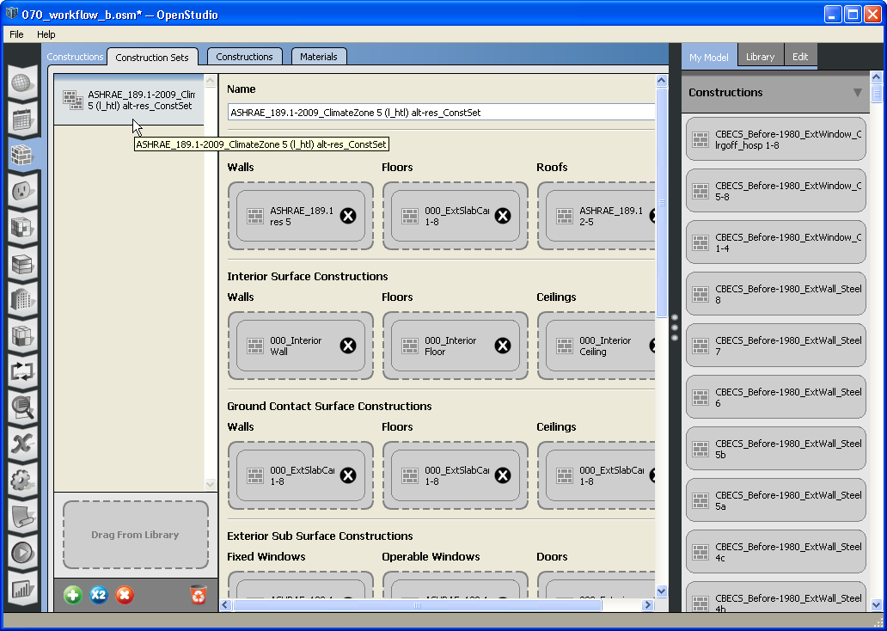
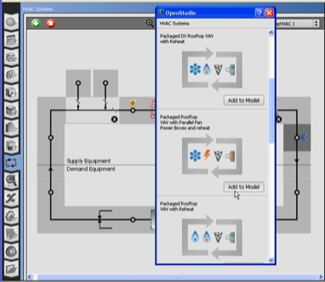
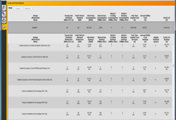
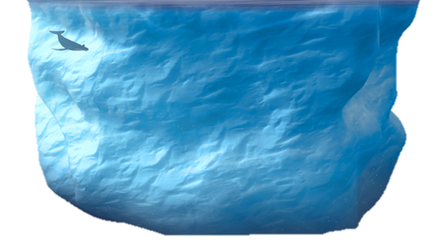
What Is OpenStudio?
Everyone knows what EnergyPlus is ➔ BEM engine
But what is OpenStudio? ➔ “Oh, it’s that SketchUp thing ...”
It started as a SketchUp plug-in …
... became a Software Development Kit (SDK) for EnergyPlus (and Radiance)
Graphical skin and SketchUp plug-in, but 90% of the mass investment is in the SDK

Slide 3
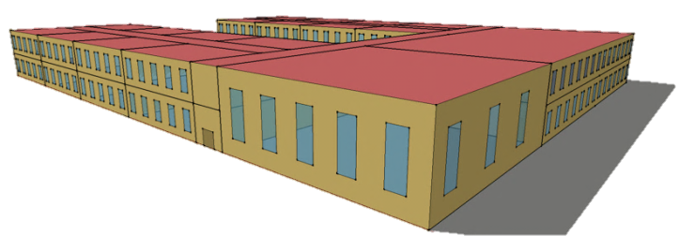
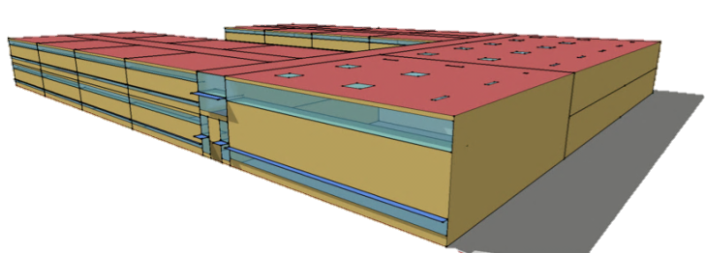
Why Is OpenStudio?
Why DOE pays for EnergyPlus?
We can. We always have. Transparency & impartiality matter!
Why does DOE pay for OpenStudio?
“If you build it (EnergyPlus), they will come (apps)” never really panned out
Demand for EnergyPlus (low) didn’t justify effort of embedding it (high)
SDK conceived to reduce app development effort improve value proposition
App demonstrates SDK (put together in ~6 months)
Has largely “worked”
EnergyPlus app development has largely increased
Most new development is OpenStudio based
In the meantime, another aspect of the value proposition has assert itself
Measures ➔ automation
Measures + Cloud ➔ large scale analysis

Slide 4




































OpenStudio Partners (Partial List)

Slide 5
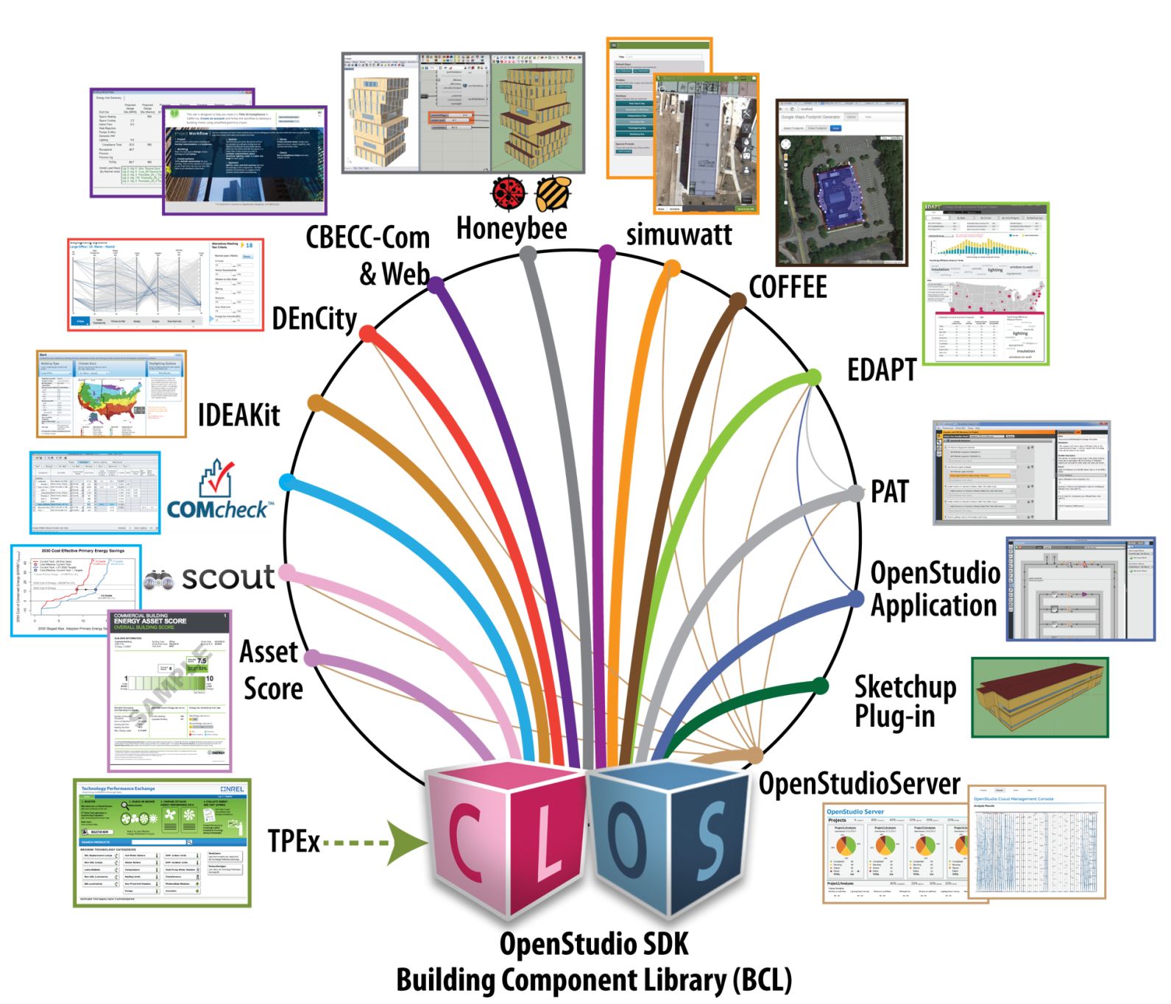



The Dream-catcher

Slide 6
OpenStudio Demo

Slide 7
Developers, Developers, Developers
OpenStudio was conceived of and implemented for application developers
Extensive API in multiple languages on multiple platforms
Commercial friendly, open source license
Shareable OpenStudio Measures leveraged by many applications
Third party developers expand DOE’s impact!
Mandatory motivational speaker:
https://www.youtube.com/watch?v=1gI_HGDgG7c
Measure writers are developers!

Slide 8
OpenStudio SDK: The Good
Manipulate input models and access simulation results programmatically!
Traverse object-oriented models and call functions, don’t read/write files
Manipulate convenient abstractions like space types, construction sets, etc.
Insulate your code from (too frequent) input format changes
Single model access to Radiance, CONTAM and other engines
High level functions for greater development productivity
Input and export gbXML, SDD, etc.

Slide 9
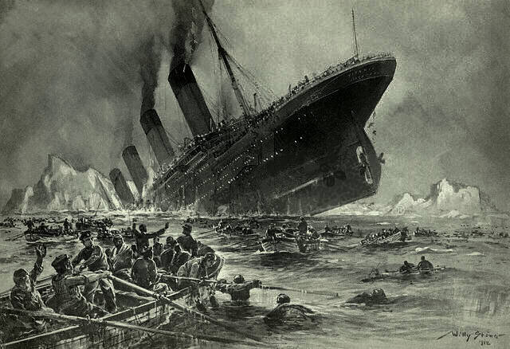
OpenStudio SDK: The Not That Good
Too large, too many components to distribute
Too hard to hard to just apply measures and run a simulation
Lacking key features needed in the market

Slide 10
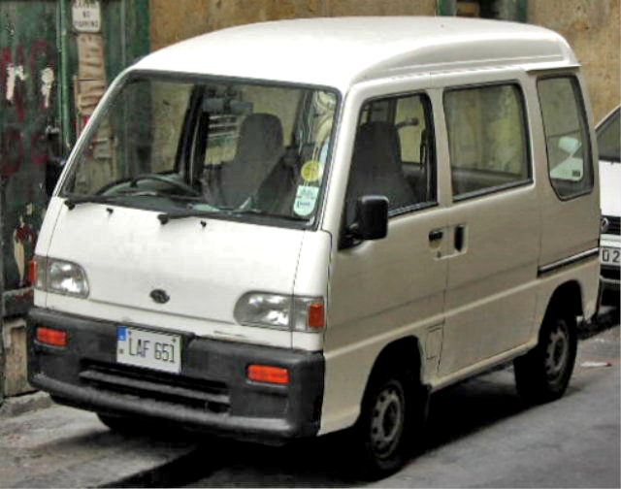
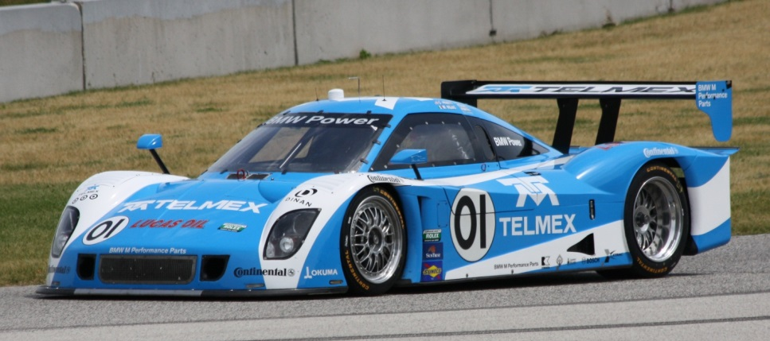
Developers talked, we listened
What we did
Reduced dependencies and simplified the installation
New command line interface for applying measures and running simulation
New killer feature: baseline automation and prototype models
Notes:
Mention Krishnan

Slide 11
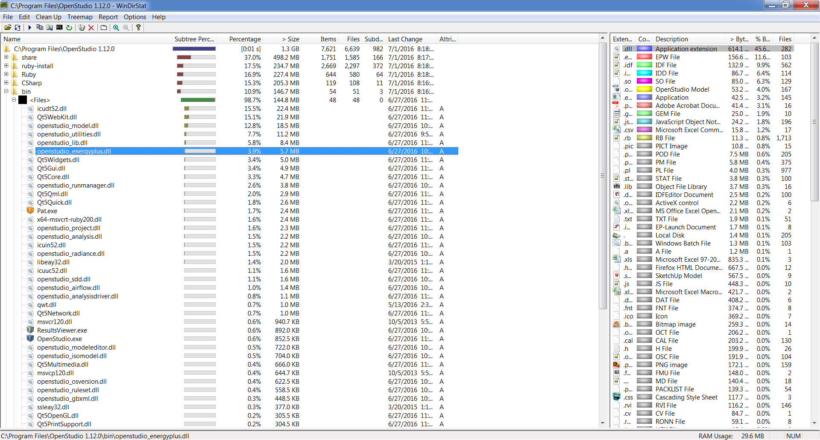
OpenStudio 1.x Installation
Lots of dynamic libraries, dependencies, resource files
Unclear what files were required or not
6,650 files, 1.3 GB

Slide 12
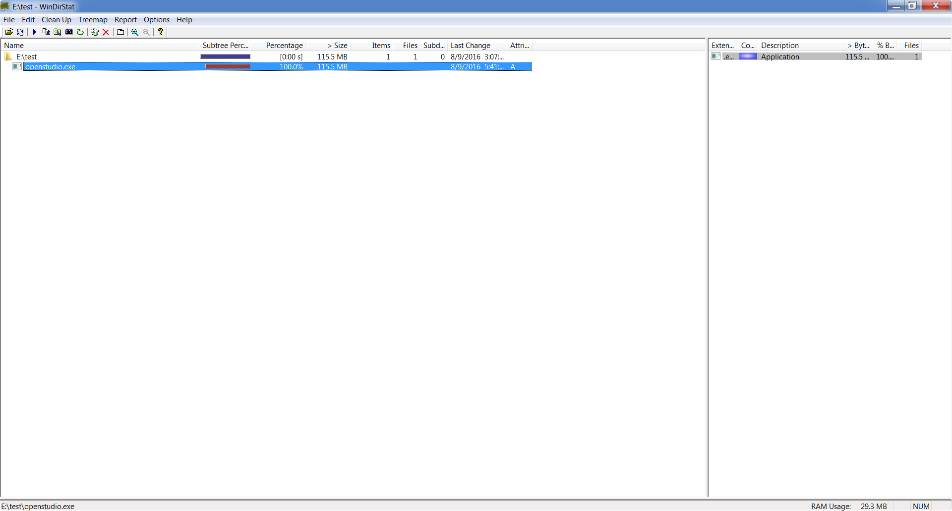
Minimal OpenStudio 2.0 Installation
Single statically linked command line interface executable
Single statically linked dynamic library for loading in Ruby and C#
1 file, 124 MB
Ruby bindings, C# bindings, OpenStudio Application, SketchUp Plug-in, PAT 2.0, and ResultsViewer can be installed as optional components

Slide 13
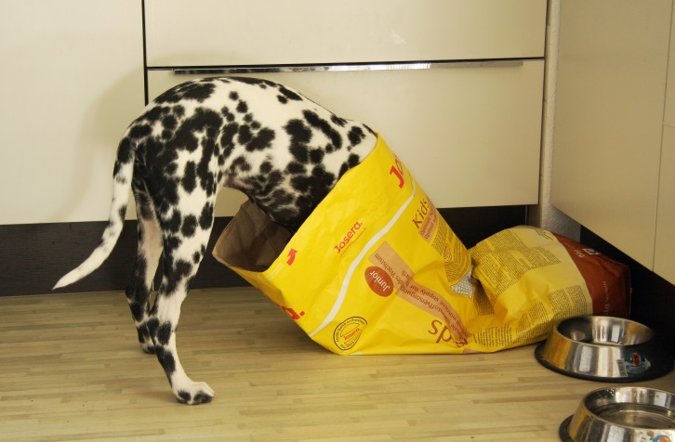
OpenStudio Command Line Interface (CLI)
What’s under the hood?
Openstudio.exe has all dependencies (including Ruby) and resource files built in
Commands to create measures, compute arguments, run measure tests
Command to run the new OpenStudio Workflow (OSW) format
What is OSW?
Simple, JSON format for describing a simulation workflow
Load seed model, apply measures, run EnergyPlus, run reporting measures
OSW + CLI = well defined unit of work, easy to post to an elastic queue
Eating our own dog food
OpenStudio Application, PAT 2.0, OpenStudio Server are all users of the CLI

Slide 14
OpenStudio Standards
OpenStudio Versions of the DOE Reference and Prototype Buildings
Single measure creates ready to run OpenStudio versions of the DOE Prototypes
Open OSMs in OpenStudio Application to inspect HVAC
Apply measures to prototypes for large scale studies, DOE SCOUT, or other applications
Baseline Automation
Given an OpenStudio model, measure creates ASHRAE 90.1 App G. baseline
Other standards can and are being added (Canadian NECB, Indian ECBC )
Several collaborators are testing on real-world models
Modular Design
OpenStudio Standards is a separate, open source Ruby gem
Easy to contribute to, https://github.com/NREL/openstudio-standards

Slide 15
Software Demo
Play along at home
Get the CLI (OpenStudio 2.0 Version 1.12.1)
Windows - http://openstudio-builds.s3.amazonaws.com/1.12.1/OpenStudio2-1.12.1-win64.7z
Mac - http://openstudio-builds.s3.amazonaws.com/1.12.1/OpenStudio2-1.12.1-Darwin.tar.gz
Check out the example
https://github.com/macumber/simbuild2016-demo
Run it
ruby run.rb /path/to/openstudio.exe

Slide 16
Other exciting develop-ments
Completed
ASHRAE Standard 140 OpenStudio Measures
Automates 179d certification of EnergyPlus using the OpenStudio API
GeneratorMicroTurbine, ElectricStorage, ElectricStorageConverter
Big thanks to Julien Marrec, you are a rockstar!
Starting soon
New prototype building types added to OpenStudio Standards
Supermarket and Data Center building types being added
ExpandObjects OpenStudio Measures
All the functionality of ExpandObjects in OpenStudio Measure format
EMS added to OpenStudio Model API

Slide 17
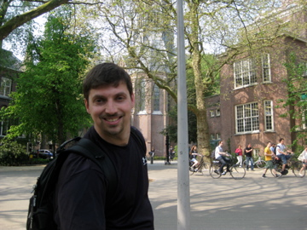
Over-Arching Themes
People (energy modelers) should not (have to) do what computers can do
Baseline generation is “mechanical” ➔ tedious, not creative, error prone
Automation eliminates (certain classes of) errors (and cheating)
Automation eliminates tedium and time/money ➔ spend more productively
Automation is more trust-worthy when it’s transparent and understandable
Become a developer! Or at least literate in development
Many people know how to do it ➔ it can’t be that hard
A little goes a [very]+ long way
It will change your (work) life

Slide 18
The Developer’s Modeling Platform
openstudio.net

Slide 19
Backup Slides

Slide 20
Image Credits
Van - By MartinHansV - Own work, Public Domain, https://commons.wikimedia.org/w/index.php?curid=1131900
Race car - https://commons.wikimedia.org/wiki/File:DP_01_Chip_Ganassi_Racing_Scott_Pruett_Memo_Rojas_Road_America_2012.jpg
Dog food - https://upload.wikimedia.org/wikipedia/commons/4/43/01_Jedes_Josera-Kr%C3%BCmel_ist_kostbar....jpg

Slide 21
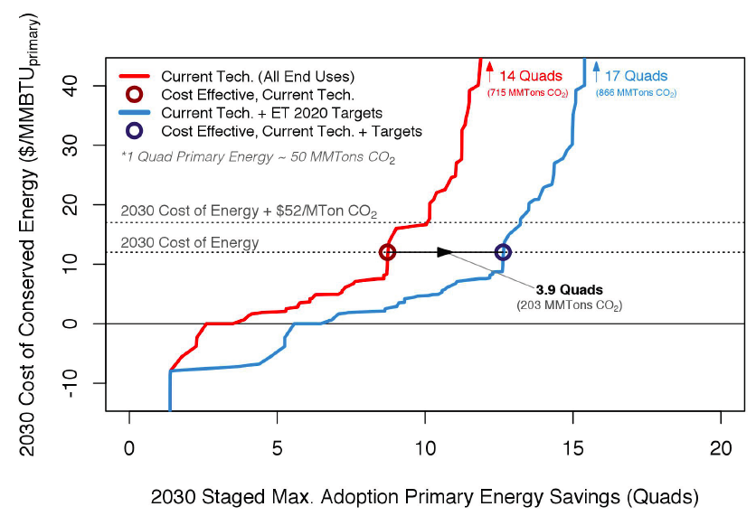
Cross-Cut: Scout
National scale EE technology impact assessment tool P-Tool 2.0
Fine-grain characterization of building energy sector
Comparable energy savings estimates using energy simulation on prototype buildings
Energy savings by end use to support measure packages
Market share approach to technology competition
Support for uncertainty
Flexible, extensible python implementation
Web interface?

